Slide 1

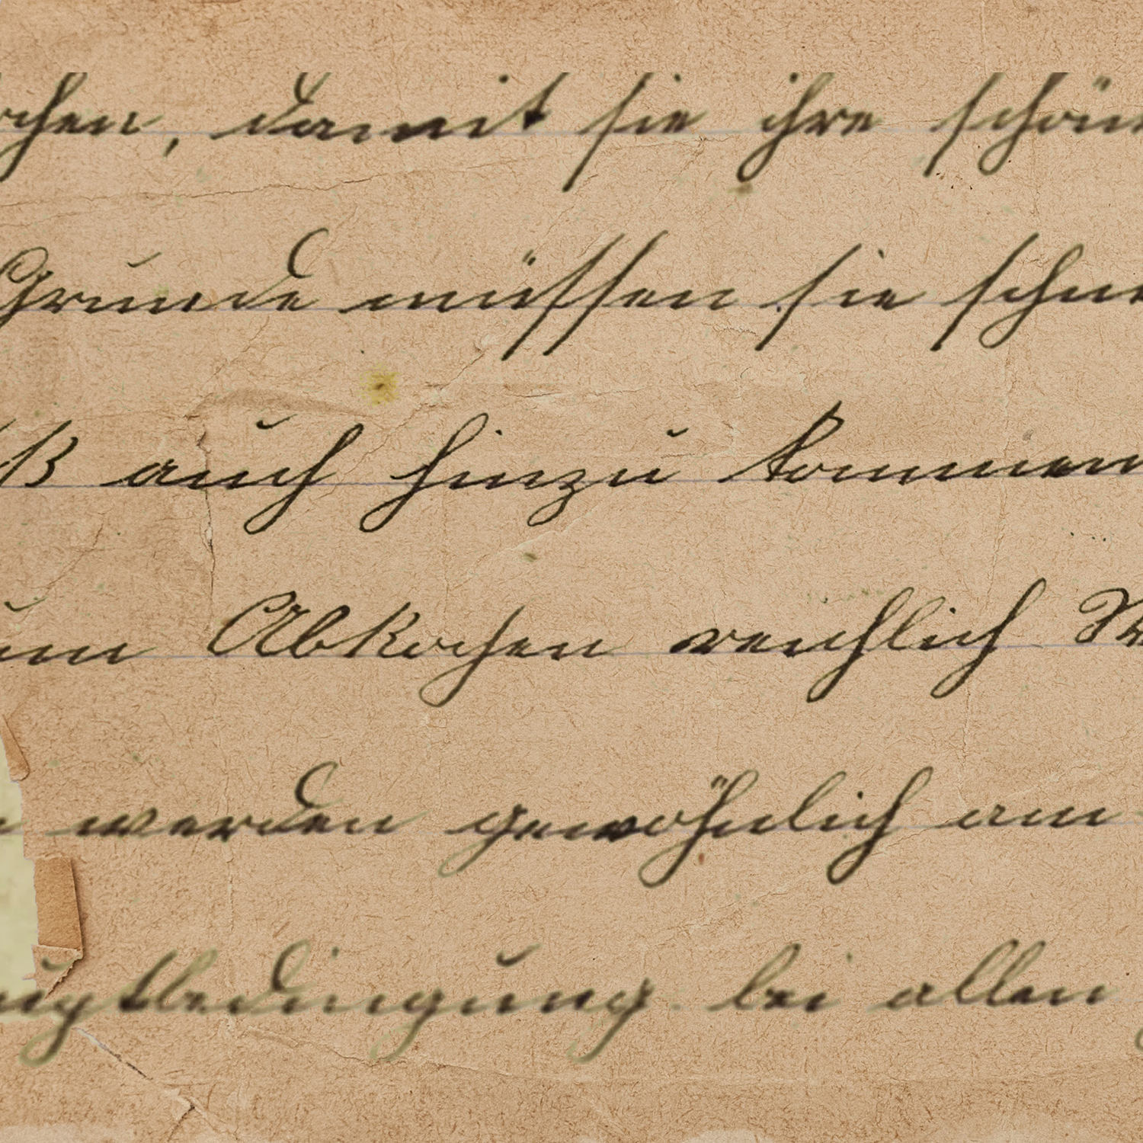







By Mahnam And Jawad
Logical
Paradoxes

Slide 2

Agenda
01.
02.
03.
04.
05.
Introduction
Epimenides Of Creten
Jourdains Card
The Barber
Conclusion and Questions

Slide 3






01
Introduction
What Are Paradoxes?

Slide 4

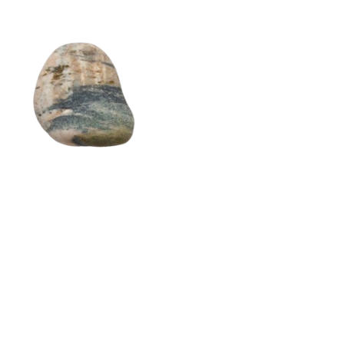
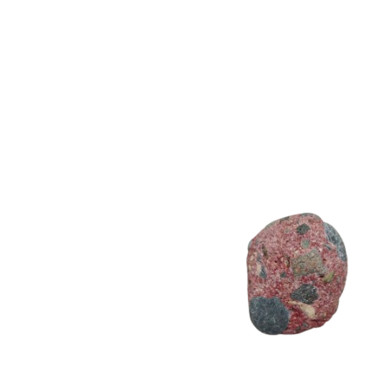
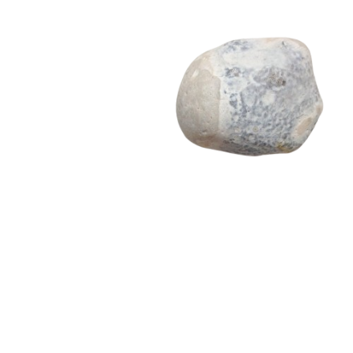
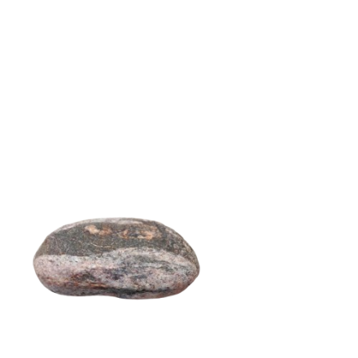
01
Introduction
Paradox Of Heap

Slide 5

01
Introduction
Heap
Heap

Slide 6
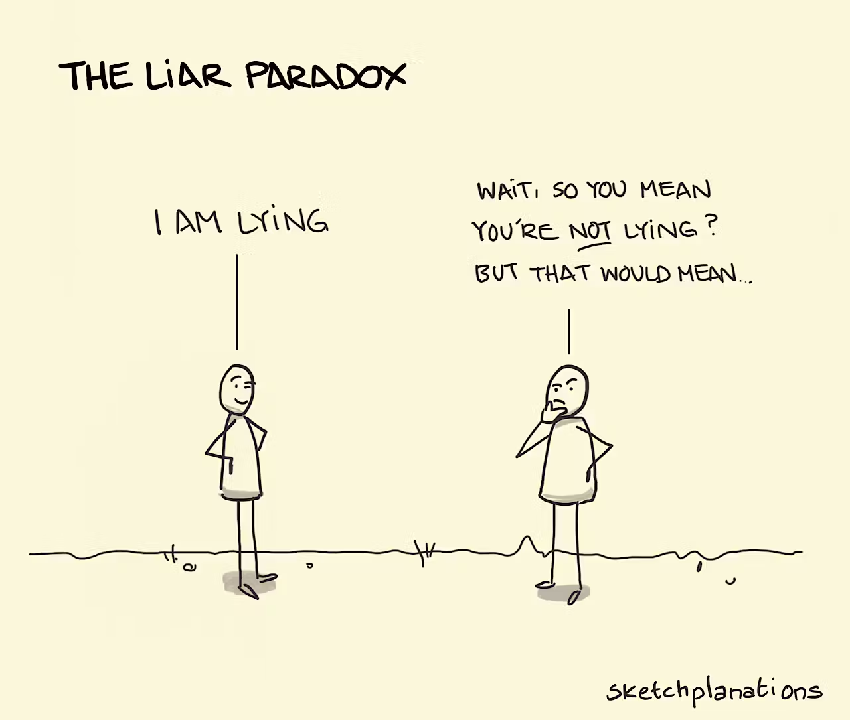
02
Epimenides

Slide 7

03
Epimenides
He Says
But..
Epimenides says that
“All Cretans are liars.”
Epimenides himself is a Cretan

Slide 8

Solution
The paradox of Epimenides the Cretan hasn't been definitively "solved" in the sense of a single, universally accepted resolution. However, various approaches have been proposed to understand and mitigate the paradox

Slide 9


04
Solutions
Contextual Interpretation
Logical Analysis
Pragmatic Approach
The Statement is not the full truth, but instead a stereotype or generalization of Cretens. Hence not all Cretens are liars.
Self-referential nature of the statement is the root cause of the contradiction, hence self-referential statements can lead to paradoxes and should be avoided in formal logic.
The paradox arises from a misunderstanding of language and communication. The sentence is just a hyperbole or spoken metaphorically.

Slide 10
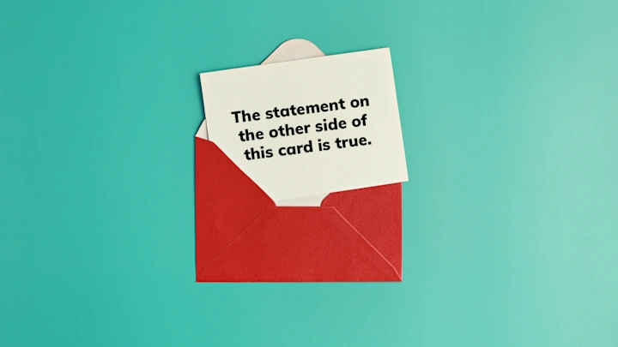
05
Jourdain's card

Slide 11
06
Jourdain
Front Side Says...
Back Side Says...
The sentence on the other side of the card is true
The sentence on the other side of the card is false

Slide 12
Solution
Since this is also a self referential statement, just like the paradox of Epimeides the Creten, this paradox also does not have a definitive solution. But, it also has some approaches to a solution.

Slide 13
07
Solutions
Limiting Self-Reference
Paraconsistent Logic
Pragmatic Approach
Restrict the types of self-referential statements. by imposing certain limitations, we can avoid paradoxes like Jourdain's card.
The paradox arises from a misunderstanding of language and communication. Self-referential statements lead to nonsensical results, hence they should be avoided
A type of logic that allows two contradicting statements to co-exist without a logical explosion

Slide 14
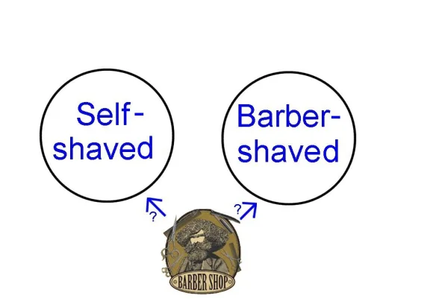
08
The Barber

Slide 15
09
The Barber
Scenario
So...
In a village, there lives a barber who shaves all and only those men, in the village, who do not shave themselves.
Does the barber shave himself?

Slide 16
Solution
Since this is also a self referential statement: this paradox also does not have a definitive solution. In the case of the barber paradox, the problem lies in the assumption that such a barber can exist. This Paradox can be solved by recognizing the statement as inherently contradictory, hence such a Barber can not exist at all.

Slide 17
Conclusions
These paradoxes highlight the limitations of self-reference and the potential for logical inconsistencies when dealing with such statements. They demonstrate how seemingly simple statements can lead to complex and paradoxical situations. Ultimately, these paradoxes remind us of the complexities of language and thought, and the importance of careful and critical thinking.

Slide 18

Questions?

Slide 19
Thank
you

